Slide 1
OFFICE SAFETY
UAF EHSRM

Slide 2
Office Safety Overview
General Office Safety
Materials Handling
Hazard Communication
Signs and Tags
Electrical
Ergonomics
Indoor Air Quality
Noise
Contacts

Slide 3
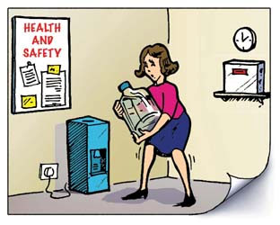
General office safety

Slide 4
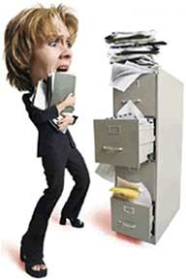
General Office Safety
What most might consider safe office activities, such as using a computer, preparing and filing paperwork, or just walking about the office or building, can and have resulted in accidents.
So you see, even in an office setting . . . . . . . . . . accidents and injuries can happen!
Some Common Causes of Accidents:
Slip, Trip, and Fall Hazards
Filing Cabinet Hazards
Poor Housekeeping
Horseplay
Cutting and Puncture Hazards

Slide 5
General Office Safety
Report icy/snowy walkways to Facilities Services Dispatch (x7000)
Wear proper footwear - EHSRM provides free ice cleats!
SLIP, TRIP, and FALL HAZARDS
Outdoor Walkways and Parking Areas
Trips on uneven walking surfaces
Slips and falls on ice/snow
Indoor Hazards
Trips on rugs and carpets that don’t lay flat
Trips on extension cords running across walkways
Trips due to poor housekeeping (clutter left on the floor)
Trips over filing cabinet draws left open
Falls from improper use of office chairs
Not looking before sitting
Chair being used as a ladder
Eliminate these hazards and reduce the risk of injury!

Slide 6
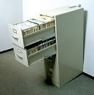
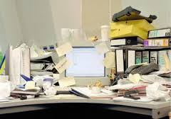
General Office Safety
Filing Cabinet Hazards
Contact with open drawers or sharp corners
Cabinets placed within walkways and doorways block exits
Pinched fingers when closing drawers
Top heavy cabinets can tip over
Poor Housekeeping
Office clutter can cause accidents
Horseplay
Joking around, such as running, throwing things, etc., can lead to accidents

Slide 7
General Office Safety
Prevention
Locate cabinets out of walking areas and doorways
Place heavier items in bottom drawers; distribute files equally from top to bottom
Keep filing cabinets out of walkways and away from doors
Never walk away leaving file drawers open
Watch the drawer as you close it (pay attention to where your fingers are)
Keep a tidy office - look professional and avoid accidents

Slide 8
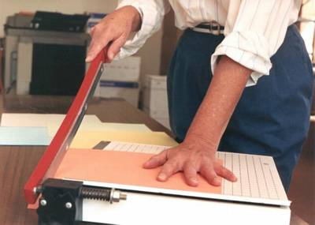
General Office Safety
Cutting and Puncture Hazards
Knives and Box Cutters
Paper Cutters
Cutting Shears
Broken Glass
Disposed Blades
Prevention
Use sharp blades (dull blades force you to use more pressure to cut, often causing accidents)
Never place hand/fingers near cutting blade
Never pick up broken glass with bare hands. Wear leather gloves and place shards inside a rigid box or container before placing in the trash. Use the same precautions when disposing of used cutting blades
Always cut away from you; never direct the cutting blade towards you
To avoid injury, be aware of hand placement relative to the position and anticipated movement of the cutting tool

Slide 9
MATERIALS HANDLING

Slide 10
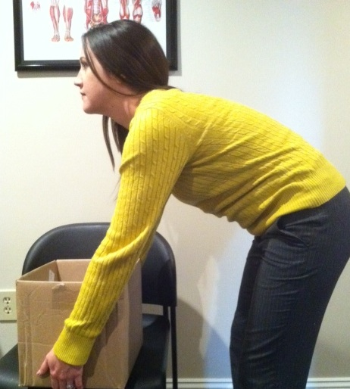
Materials Handling
Office duties may require risky movements
that often result in back or other injuries.
These movements can include:
Twisting at the Waist When Lifting
Lifting or Moving Heavy Items
Bending Over
Reaching Overhead or Outward While Lifting
The good news is . . . . injuries caused by these activities can be avoided by following a few simple guidelines

Slide 11
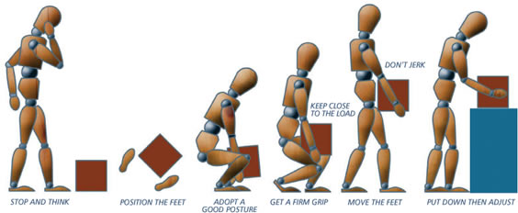
Materials Handling
Preventing Lifting Injuries
Use proper lifting techniques
Think about the task at hand
Balanced stance with feet placed shoulder-width apart
Squat down (bend your knees) and hug the load close
Grasp firmly with entire hand. Use palms and not just fingers
Lift Gradually, using legs, abdomen, buttock muscles
Once standing and carrying the load, never twist at the torso.
Instead, shuffle your feet to the
direction desired.
Lower the load slowly, don’t jerk

Slide 12
Materials Handling
Tips to Help Avoid Injury
Never carry loads which obscure your clear view ahead
Always maintain sight of where you are stepping
Do not lift when your grip is awkward or unsecure
Ensure your footing is stable
Never lift heavy loads above the shoulders
Avoid bending by arranging work station at waist level
Limit weight lifted to what you can only carry comfortably
Best lifting/carrying zone: between shoulders and waist!
When in doubt, ask for help. It beats getting injured!

Slide 13
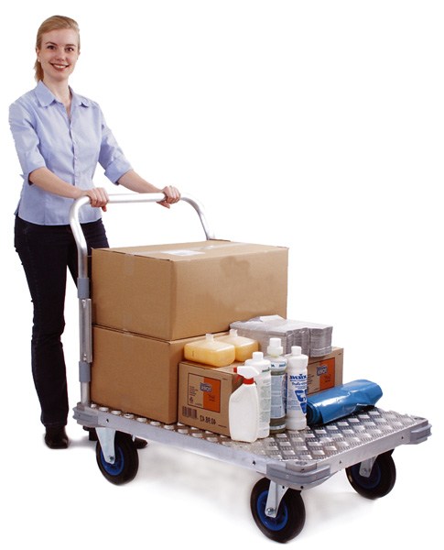
Materials Handling
Material Handling Aids
Use a push cart, hand-truck, or dolly for heavier loads
Always secure the load to prevent shifting during movement
Always push the load straight ahead; pulling the load results in
twisting at the torso which increases the risk of injury
Personal Protective Equipment
Wear leather gloves when handling materials with sharp edges
Wear safety glasses when removing banding around packages
Good Physical Conditioning
Helps prevent strains, sprains, and other injuries
Situational Awareness
Learn to recognize and anticipate risky activities
Take protective measures by utilizing this training

Slide 14
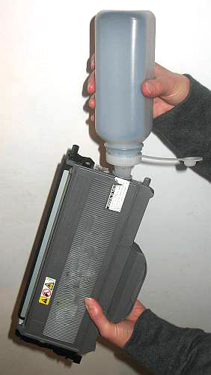
HAZARD COMMUNICATION

Slide 15
Hazard Communication
Office workers who encounter hazardous chemicals in only isolated instances are not required to comply with the Occupational Safety and Health Administration (OSHA) Hazard Communication Standard
OSHA considers most office chemical products to be exempt under the provisions of the rule, either as articles or as consumer products
Typical office chemical products, such as “White-Out”, adhesives, white board cleaners, toners, etc., meet the above provision as they present a low risk of hazard
Departments that fall under the above conditions are only required to maintain a “UAF Hazard Communication Plan for Office Workers” for their applicable office(s). You can find this plan at:
http://www.uaf.edu/safety/industrial-hygiene/hazard-communication/
The department supervisor must sign and maintain a copy of the plan which all department employees must read and acknowledge

Slide 16
Hazard Communication
Hazard Communication Plan Thresholds
Some offices may require additional Hazard Communication training depending on their specific activities outside of the office. Examples include:
Using hazardous chemicals to service multiple machines
Using hazardous chemicals for extended periods or in quantities beyond normal consumer use
Participating in field or lab work using hazardous chemicals
Receiving and storing hazardous chemical for a researcher or professor
If any of these conditions apply to you, consult page 2 of your “UAF Hazard Communication Plan for Office Workers” for additional guidance on additional written plans or training that may be required.

Slide 17
Hazard Communication
Physical Agent Data Sheets (PADS)
Alaska Administrative Code 8 ACC 61.1110 also requires that physical hazards (agents) are communicated to employees
Physical agents include ionizing and non-ionizing types of radiation, heat and cold stress, noise, and hand-arm vibration
Typical office activities should not expose employees to these physical agents
However, if physical agents are introduced into the office area workers perform other duties outside of the office that expose them to physical agents, additional PADS training is required.
Specific training PADS for these agents can be found at: http://www.uaf.edu/safety/industrial-hygiene/hazard-communication/

Slide 18
signs and tags

Slide 19
SIGNS AND TAGS
Many operations involve a certain element of risk
Safety signs and tags have been developed as one means of preventing workplace accidents and injuries. They warn about hazards:
So you can take appropriate precaution
Using distinguishable sign color, symbols and labels to identify levels of hazard and risk
Using DANGER, CAUTION, SAFETY INSTRUCTION and other signs and tags

Slide 20
SIGNS AND TAGS
Danger:
Indicates immediate danger
and that special precautions
are required
Caution:
Indicates possible hazard against which proper precautions should be taken

Slide 21
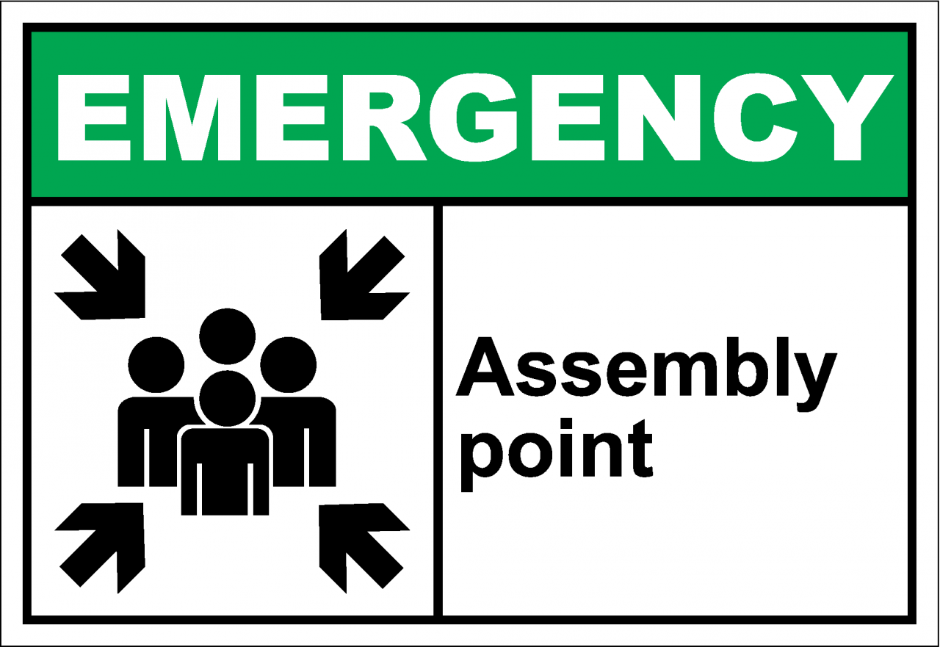
SIGNS AND TAGS
Safety Instructions: Provide general instruction and suggestions relative to safety measures
Ask your supervisor about your work-specific signs

Slide 22
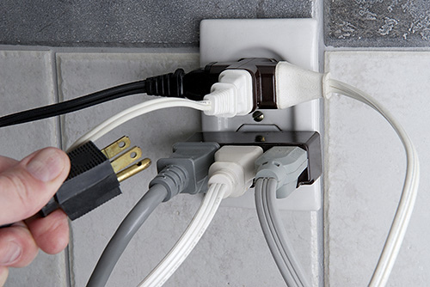
Electrical Safety

Slide 23
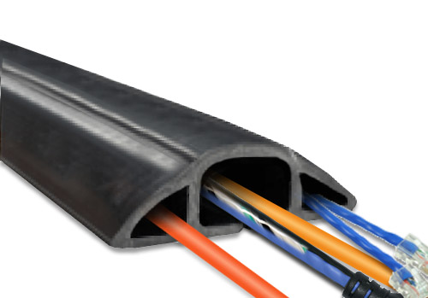
Basic Electrical Safety Precautions
Overloaded Outlets: Overloading electrical circuits and extension cords can result in a fire
Electrical Cords across Walkways and Work Areas:
Present a tripping hazard . . . use a cord runner instead
Improper Placement of Cords: Never pull or drag over
sharp objects that may cause cuts in the insulation. Never place on hot or wet surfaces, or through walls, windows, doors, or ceilings
Defective, frayed or improperly installed cords: Exposed wires can lead to electrical shock, always inspect before use
Electrical Panel Doors: Should always be kept closed to protect against "electrical flashover" in the event of an electrical malfunction. Maintain 36” of clearance in front of electrical panels!

Slide 24
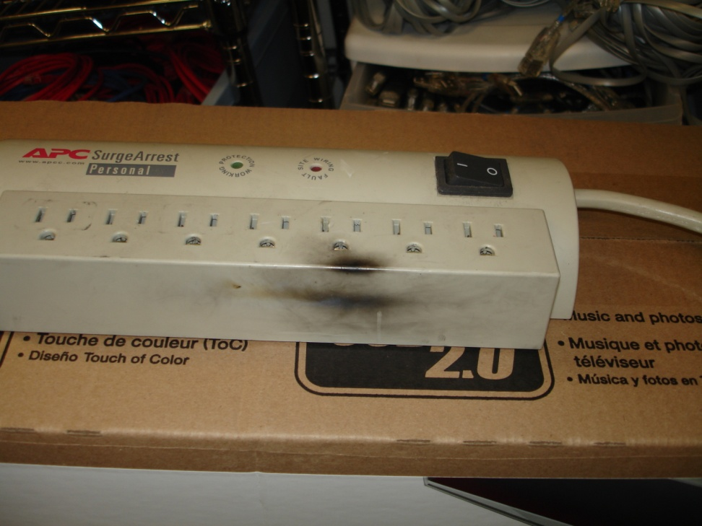
Basic Electrical Safety Precautions
Unsafe/Non-Approved Equipment: Look for UL Listed Label
Live Parts Unguarded: Ensure wall receptacles have covers
Pulling of Plugs to Shut Off Power: Use equipment switch or have one installed
Jammed Office Machinery: Always follow the equipment manual for clearing a jam
Defective Equipment: Replace defective equipment immediately!
Example: Even though this power strip
was involved in an electrical fire, it had
not been taken out of service

Slide 25
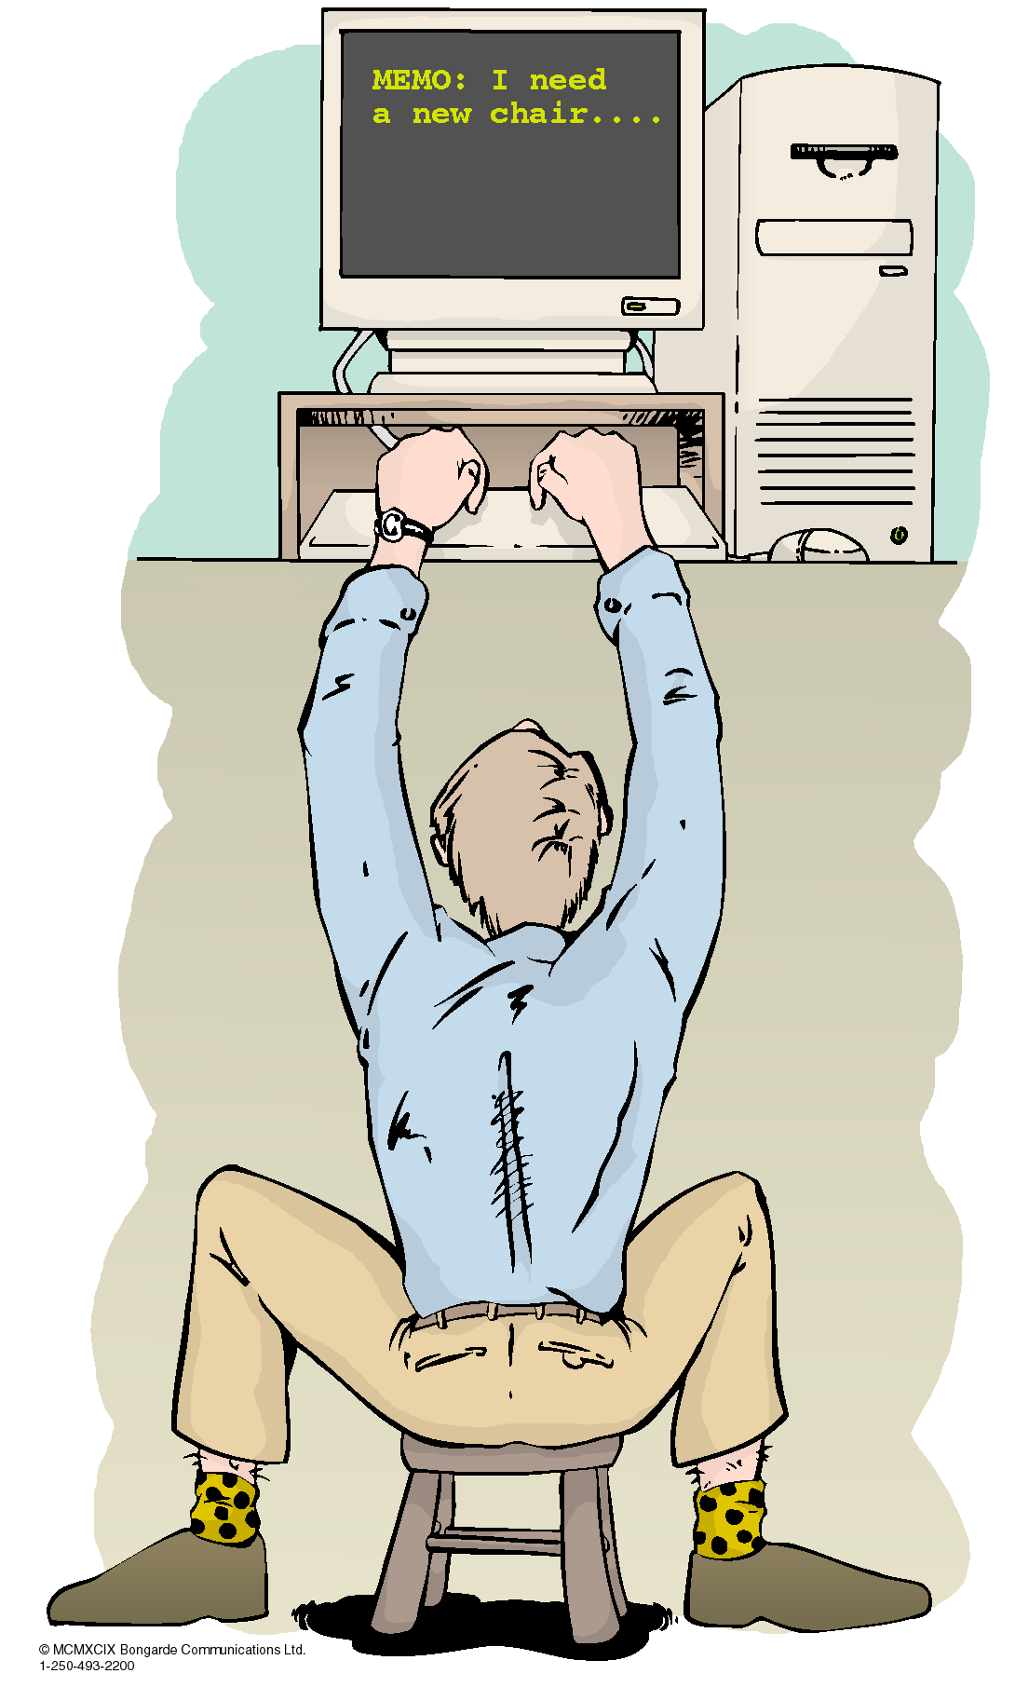
ERGONOMICS

Slide 26
Ergonomics
Ergonomics - fancy word for the science of arranging and adjusting the work environment to fit the employees body.
The UAF Ergonomic Program offers:
1. Training and Awareness
2. Workstation Evaluations
3. Corrective Actions and Recommendations
The university is responsible for injuries sustained due to ergonomics under OSHA Regulations 29 CFR 1910, General Duty clause

Slide 27
Occupational Risk Factors
Ergonomics
Repetition – task or series of motions performed over and over
Forceful Exertions - amount of physical effort required to complete task
Awkward Postures - reaching, twisting, bending, holding fixed positions
Contact Stress – localized pressure exerted against the skin by external force
Signs and Symptoms include: pain, numbness, tingling, stiffness, decreased range of motion

Slide 28
Mitigation Factors
Ergonomics
Repetition: take adequate breaks from tasks that you complete over and over again
Forceful Exertions: Minimize force during tasks using as light of a touch as possible
Awkward Postures: locate phones and computers so they are easy viewed and used and no twisting is required for access.
Contact Stress: if you find you are leaning or resting body parts on hard surfaces change configurations of you equipment, phone or chair height
Complete the self evaluation checklist located at http://www.uaf.edu/safety/ergonomics-2/

Slide 29
Help
Ergonomics
Don’t postpone calling if something hurts – EHSRM may be able to help
Loss prevention funding may be available to purchase ergonomic chairs, desks, keyboards and other equipment – you must have an ergonomic assessment to qualify.
For more information
http://www.uaf.edu/safety/industrial-hygiene/ergonomics/
Contact Carol Shafford 474-5413 or cashafford@alaska.edu

Slide 30
INDOOR AIR QUALITY

Slide 31
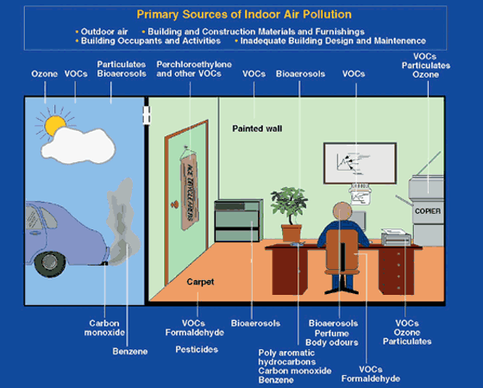
Indoor Air Quality
Many things can affect indoor air quality:
Ventilation
Smoking and vehicle exhaust
Temperature, humidity, and carbon dioxide
Mold
Office supplies and personal products
Dust and other particulates

Slide 32
Indoor Air Quality (IAQ) Factors
Indoor Air Quality
IAQ can be affected by:
Ventilation
Blocking open doors that have automatic door closers
Blocking Vents
Making small offices out of larger offices
Smoking and vehicle exhaust
Do not smoke or idle a vehicle near building entrances or air intakes
Contact Parking Services (x7348) or Campus Police (x7721) if you see someone idling or smoking near air intakes or building entrances.

Slide 33
Indoor Air Quality Factors (cont.)
Indoor Air Quality
Mold
Mold occurs naturally outdoors and indoors
Mold needs water to grow, as well as a source of food (sheetrock, paper, wood)
If your office is flooded, it is extremely important to dry the walls and carpet as soon as possible (24-48 hours)
Call Facilities Services (x7000) to report the flood or leak so that it can be repaired

Slide 34
Indoor Air Quality Factors (cont.)
Indoor Air Quality
Office supplies and personal products that can cause respiratory and eye irritation
Dry erase markers and cleaners, markers
Bleach and bleach wipes
Window and surface cleaners
Perfumes
Air fresheners, deodorizers and potpourri
Dust and other particulates can cause respiratory irritation
Dust your work area regularly and keep it clean
Custodial stuff cannot dust your desk for you!

Slide 35
Noise
PRODUCTIVITY
Inefficient/lost communication
Work stoppage for communication
Incomplete instructions/knowledge
Cost
of
Noise
HEARING LOSS
RISK
- Wasted Investment in
Ineffective solutions
- Increase in Workers Comp
Claims, Potential Law
Suits, Insurance
Premiums
Greater risk of accidents and fatalities due to reduced situational awareness
Reduction of
productivity

Slide 36
Noise
Noise is any sound that is loud, unpleasant, unexpected, or undesired
Acceptable levels will vary with the individuals in the office
While it is unlikely that noise levels in offices will reach damaging levels, noise can:
Create physical and psychological stress
Reduce productivity
Interfere with communication and concentration

Slide 37
Noise
Sources of noise in the office include:
Printers/fax machines
Computers
Phones
Voices
Ventilation/Heating Systems
High foot traffic
Radios

Slide 38
Noise
Noise can be reduced by:
Choosing the quietest equipment
Maintaining equipment
Reducing the ring volumes on phones
If radios are allowed, keeping volumes low
Placing noisy equipment in a separate room or as far away from work stations as possible
Rearrange work areas to isolate foot traffic
Carpet, walls, and cubicles can help dampen noise

Slide 39
Contacts
Main Line and Ergonomics
Carol Shafford 474-5413
cashafford@alaska.edu
Industrial Hygienists
Tracey Martinson 474-6771
tamartinson@alaska.edu
Andy Krumhardt 474-5197
apkrumhardt@alaska.edu
Occupational Safety, Accident and Injury
Gary Beaudette 474-2763
gsbeaudette@alaska.edu
Kim Knudsen 474-5476
klamb1@alaska.edu
Hazardous Material
Richard Deck 474-5617
redeck@alaska.edu
Kris Riley 474-7889
kcriley@alaska.edu
www.uaf.edu/safety/

