Slide 1
Unmanned Aircraft Systems (UAS) 101

Slide 2
Overview
Unmanned Aircraft Systems
FAA Authority
Hobby/Recreational Operations
UAS Registration
Small UAS Rule (Part 107)
Becoming a Pilot
Operating Rules
Next Steps in Integration
Focus Area Pathfinders & Extended Operations
Operations Over People Rulemaking
Research, Security, & Enforcement
Outreach Efforts

Slide 3
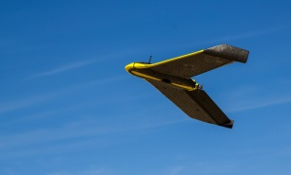
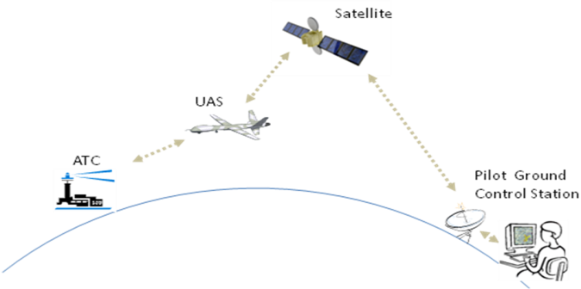
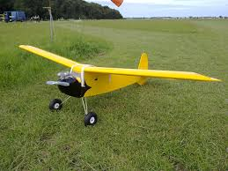
What is a UAS?
A UAS is a system:
Unmanned Aircraft
Ground Control Station
Command & Control Link(s)
Also known as:
Unmanned Aerial Vehicle (UAV)
Remotely Piloted Aircraft System (RPAS)
RC Model Aircraft
Drone
Communication
Notes:
UAS requires three main parts working together in order to function properly.
The aircraft itself that we are most familiar
The Ground Control Station including all its hardware and software
And last but not least the radio spectrum that controls the aircraft
While unmanned aircraft have been around for years, many of us know them by a variety of terms; They come in a variety of shapes and sizes; from the Global Hawk with wing span of a B737 to ones that can fit in your hand
UAS can range in weight from a few grams to thousands of pounds and can operate at altitudes from near surface to the edge of space
Not limited to fixed wing single engine aircraft – Unmanned helicopters and airships are flying today
Some Unmanned Aircraft remain aloft for minutes others for days
Research designs may allow UAS to remain aloft for months
Some Unmanned Aircraft fly slowly while others are capable of very high speeds
Some Unmanned Aircraft require a prepared runway while others can be launched and recovered from unprepared fields, ships, aircraft, rooftops, or by hand

Slide 4
Why Use a UAS?
UAS operations are particularly effective for missions that are dangerous or dull
Humans are not put at risk
Continuous operations are possible
Operations with UAS often cost less than using manned aircraft
Notes:
UAS can conduct inspections or provide situational awareness in places and environments that normally could not otherwise be done (including fire, chemical, and radioactivity).
These aircraft are ideally suited for many uses. Trying to list all the various uses of UAS would be a very long process.
UAS are often far less expensive than manned aircraft to do the same job.

Slide 5
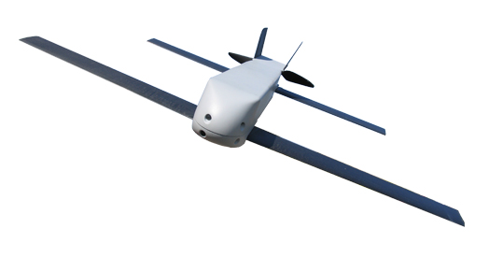
What is the FAA’s Authority?
The FAA has the authority to manage airspace and civil aircraft operations
49 U.S.C. §40103(a)(1)
An aircraft is any device used, or intended to be used, for flight
49 U.S.C. §40102(a)(6)
UAS are aircraft and must comply with FAA regulations
Notes:
By statute, the FAA has exclusive authority to manage the airspace and civil aircraft operations.
The same statute defines “aircraft” as “any contrivance invented, used, or designed to navigate, or fly in, the air.” This includes UAS and model aircraft.
There are several regulations that state “no person may operate an aircraft unless…” So, because UAS meet the definition of “aircraft” they must follow these rules.
There are state, local, or triabl restrictions that do impact some UAS operations – such as limits on where you can launch or land UAS. Like the TV man used to say “Check local listings”
49 USC 40103: Sovereignty and use of airspace
40103 (1) (a): the United States government has exclusive sovereignty of airspace of the United States
49 USC 40102: Definitions
40102 (a) (6): “aircraft” means any contrivance invented, used, or designed to navigate, or fly in, the air.
14 CFR 1.1: Unmanned aircraft means an aircraft operated without the possibility of direct human intervention from within or on the aircraft.
PL 112-95 331: definitions of UAS as determined by Congress
PL 112-95 336: Special rule for model aircraft (now also regulated in Title 14 CFR Part 101)

Slide 6
Types of UAS Operations
 | Recreational Operations | Non-recreational/Commercial Operations
Pilot Requirements | No pilot requirements | Must have Remote Pilot Airman Certification Must be 16 years or older Must pass TSA vetting
Aircraft Requirements | Must be registered if over 0.55 pounds | Must be less than 55 pounds Must be registered if over 0.55 pounds Must undergo pre-flight checklist
Location Requirements | Must notify all airports and air traffic control (if applicable) within five miles of proposed area of operations | Class G airspace without ATC permission Class B, C, D, and E require ATC permission
Operating Rules | Must ALWAYS yield right of way to manned aircraft Must keep aircraft in visual line-of-sight Must follow community-based safety guidelines | Must keep aircraft in visual line-of-sight* Must fly under 400 feet* Must fly only during daylight hours* Must fly at or below 100 mph* Must yield right of way to manned aircraft* Must NOT fly over people* Must NOT fly from a moving vehicle*
Definitions | Education or recreational flying only | Flying for commercial use Flying incidental to a business Flying public aircraft operations
*These requirements are subject to waiver.

Slide 7
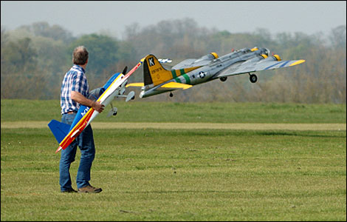
Hobby/Recreational Aircraft
Generally, hobby/recreational operators do not need FAA authorization to fly, but they must fly safely at all times:
Avoid manned aircraft
Maintain visual line-of-sight
Fly only for hobby/recreation
They must register and mark their UAS before flying outdoors
UAS between 0.55 pounds and 55 pounds may register online
Notes:
Interpretation of the Special Rule for Model Aircraft Published in the Federal Register – June 2014
FAA Modernization and Reform Act of 2012 redefined “model aircraft” – Section 336
Interpretive Rule published to clarify to public meaning of the Law and regulations
Law requires notification of airport when model aircraft operated within 5 miles of published airport center
Received more than 33,000 public comments following publication to the Federal Register
FAA published Advisory Circular 91.57A on September 2, 2015 to ensure guidance to model aircraft users is in line with Section 336 and the FAA’s Interpretation (this replaces AC 91-57)

Slide 8
Interpretive Rule
FAA published guidance in June 2014 for hobby or recreational use of UAS
This guidance clarifies that:
Model aircraft must satisfy the criteria in the Act to qualify as model aircraft and to be exempt from future FAA rulemaking action
Consistent with the Act, if a model aircraft operator endangers the safety of the NAS, the FAA has the authority to take enforcement action against those operators for safety violations
Status: FAA evaluating comments to determine where clarification is needed
https://www.federalregister.gov/articles/2014/06/25/2014-14948/interpretation-of-the-special-rule-for-model-aircraft
Notes:
Not a new regulation – interpreting the language of section 336 so that everyone will have a common understanding of the law and existing rules
Strictly for hobby or recreation – no business or financial gain, or incidental to a business
Must notify ATC when flying within 5 miles of an airport with a tower
Flying over the objection of ATC or airport operators may be considered endangering the safety of the NAS
FAA expects modelers to know the FAA’s existing safety regulations – intended to prevent endangerment to safety
Does not limit the FAA’s authority to take enforcement action against those who endanger the safety of the NAS
FAA will investigate reported incidents and determine if enforcement is necessary
Goal to make sure inspectors give standard information on how to comply with regulations
Full Interpretation of the Special Rule for Model Aircraft can also be found on the FAA’s UAS Integration website – www.faa.gov/uas/regulations_policies

Slide 9
Online UAS Registration
Applies to small UAS 0.55-55 lbs. flown outside
Owner must provide name, address, email
Non-recreational owners must provide make, model, and serial number (if available) of each sUAS
Notes:
The DOT and the FAA want this promising segment of the aviation industry to thrive, while encouraging a culture of accountability and responsibility among UAS operators that mirrors that of the larger aviation community. Greater accountability will help protect innovation, which is in danger of being undermined by reckless behavior.
Registration promotes responsible use and helps to foster innovation by making the registration requirements less burdensome on commercial UAS operators flying under a Section 333 exemption
In October 2015, the FAA announced a task force to develop recommendations for a small UAS registration process
The Task Force met for three days in November 2015, delivering its final recommendation report on November 20
The FAA published an Interim Final Rule on December 14
Full details are available at www.faa.gov/uas/registration
All UAS between 0.55 and 55 pounds must be registered through the online system and be marked with the registration number
Hobby operators can register once and apply registration number to multiple aircraft; commercial/public operators must register each small UAS separately and apply registration number to each aircraft
Hobby registration opened December 21
Commercial registration opened March 31, 2016.
As of the end of September, more than 550,000 people had registered with the FAA using the online system

Slide 10
The Small UAS Rule (Part 107)
First rules for routine operation of small UAS (<55 pounds)
Took effect August 29, 2016
Recreational operators may fly under Part 107 or Public Law 112-95 Section 336/Part 101
Notes:
On June 21, 2016, the Department of Transportation’s Federal Aviation Administration finalized the first operational rules for routine commercial use of small unmanned aircraft systems (UAS or “drones”), opening pathways towards fully integrating UAS into the nation’s airspace.
The new rule offers safety regulations for unmanned aircraft drones weighing less than 55 pounds that are conducting non-hobbyist operations.
Part 107 will not apply to model aircraft. Model aircraft operators must continue to satisfy all the criteria specified in Section 336 of Public Law 112-95 (which will now be codified in Part 101), including the stipulation they be operated only for hobby or recreational purposes.
Part 107 allows routine access for certain small UAS operations
This process largely replaces the Section 333 grant of exemption process for commercial or public UAS operators
It goes into effect sixty days after it is published
Current Section 333 operators may operate under the conditions and limitations of their Section 333 or they may operate under the requirements of 107
They may not mix-and-match from the rules – if they remain under 333, they must follow all the conditions of 333, including the requirement that the PIC be a certificated airman (of a manned aircraft)
Under 107, a non-recreational operator is required to:
Hold a Remote Pilot Certificate
Be 16 years or older
Pass TSA vetting
This rule does not change any of the guidance or regulations for hobby aircraft

Slide 11
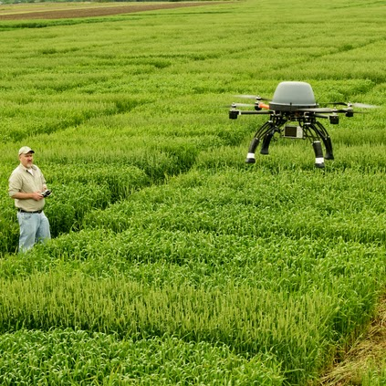
Part 107 Basics
UAS operators must obtain a Remote Pilot Certificate
Visual line-of-sight, daylight operations
400 feet or below in uncontrolled (Class G) airspace; other airspace use requires authorization
UAS must weigh less than 55 lbs. and be registered
Notes:
The rule’s provisions are designed to minimize risks to other aircraft and people and property on the ground.
The rule requires pilots to keep an unmanned aircraft within visual line of sight.
Operations are allowed during daylight and during twilight if the drone has anti-collision lights.
The rule also address height and speed restrictions and other operational limits, such as prohibiting flights over unprotected people on the ground who aren’t directly participating in the UAS operation.
The rule permits UAS flight in uncontrolled (Class G) airspace without permission from air traffic control. Flights in controlled airspace (Class B, C, D, and E) require authorization from air traffic control. The FAA is setting up a centralized, online authorization portal for such requests, which will be available after the rule is effective in August 2016.

Slide 12
Becoming a Pilot under Part 107
Must be 16 years old or older
Must read, write, speak English
Must pass an aeronautical knowledge exam at an FAA-approved Knowledge Testing Center
Part 61 certificate holders can take online training at faasafety.gov instead of the knowledge exam
Must undergo TSA background security screening
Notes:
UAS operators who fly under the small UAS rule must obtain a Remote Pilot Certificate (RPC).
The Remote Pilot must:
Be at least 16 years old
Be able to read, write, speak, and understand English (exceptions may be made for medical reasons, such as a hearing impairment)
Be in a physical and mental condition to safely operate a small UAS
Pass the initial aeronautical knowledge exam at an FAA-approved knowledge testing center
Have their certificate easily accessible when operating
The certificate is valid for two years. Remote pilots will have to pass a recurrent knowledge exam.
First time pilots must pass an aeronautical knowledge exam at an FAA-approved Knowledge Testing Center. The cost is approximately $150 (depending on the Testing Center).
Part 61 airmen certificate holders must complete an online training course on the FAA Safety Team website.
Detailed information about how to obtain a RPC is available on our website at http://www.faa.gov/uas/how_to_fly/business/remote_pilot_cert

Slide 13
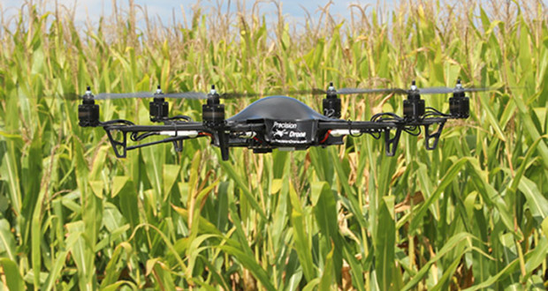
Operating Rules
Visual line-of-sight only
Daylight or civil twilight only
No operations over people
Must yield right-of-way to manned aircraft
One UAS per operator
Max groundspeed of 100 mph
External load operation only permitted if the load does not affect flight operations or control
Notes:
Operating/Airspace Rules
The basic requirements are as follows for flights under part 107:
UAS must weigh less than 55 lbs.
Maximum altitude is 400’ AGL
Maximum speed is 100mph/87 knots
Operations limited to Class G airspace
Visual line-of-sight only
No operations over people
Must yield right-of-way to manned aircraft
One operator per UAS at a time
External load operation only permitted if they do not affect flight operations or control

Slide 14
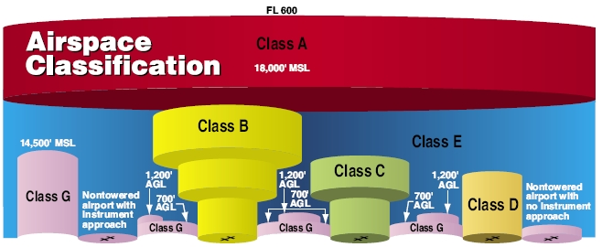
Part 107 Airspace Requirements
Operations in Class G without ATC authorization
Operations in Class B, C, D & Class E surface areas require ATC authorization
Phased approach to airspace authorizations
Online portal available at https://www.faa.gov/uas/request_waiver/
Notes:
The rule permits UAS flight in uncontrolled (Class G) airspace without permission from air traffic control. Flights in controlled airspace (Class B, C, D, and E) require authorization from air traffic control. The FAA is setting up a centralized, online authorization portal for such requests, which is available at https://www.faa.gov/uas/request_waiver/.
The FAA is taking a phased approach to airspace authorizations. All requests for airspace authorization under Part 107 must go through this portal.
Operators may submit their requests now, but air traffic facilities will receive approved authorizations, if granted, according to the following tentative schedule:
Class D & E Surface Area: October 3, 2016
Class C: October 31, 2016
Class B: December 5, 2016
The safety criteria for the waivers can be found on the UAS website at: https://www.faa.gov/uas/request_waiver/media/performance_based_standards.pdf.

Slide 15
Focus Area Pathfinders – Expanding Operations
3 Focus Area Pathfinder Partners:
CNN
Exploring visual line-of-sight operations over people
Precision Hawk
Exploring extended visual line-of-sight operations in rural areas
BNSF Railways
Exploring beyond visual line-of-sight operations in rural areas
Notes:
Announced in May 2015 at AUVSI Unmanned Systems
Partnering with three U.S. companies to research UAS operations beyond the scope of the proposed small UAS rule (part 107)
Partners committed resources to perform research in three areas:
Focus Area 1 – CNN: operation over people
Focus Area 2 – PrecisionHawk: operation outside of the pilot’s direct vision (extended visual line-of-sight) in rural areas
First test flights took place in North Carolina late November 2015
Focus Area 3 – BNSF Railroad: operation beyond visual line-of-sight in rural areas
First test flights took place in New Mexico November 2015

Slide 16
Operations Over People Rulemaking
Stakeholder committee recommended regulatory framework for UAS operations over people to FAA on April 1, 2016
Report outlines four categories of small UAS operations
Defined primarily by level of risk of injury posed
The FAA is considering these recommendations and developing a performance-based rule that would allow operations over people under part 107
Proposed rule expected by end of 2016
Notes:
The FAA announced the establishment of an aviation rulemaking committee (ARC) with industry stakeholders in February 2016.
The ARC members developed recommendations for a regulatory framework that would allow certain UAS to be operated over people who are not directly involved in the operation of the aircraft.
The FAA is taking this action to provide a more flexible, performance-based approach for these operations that what was considered for Micro UAS in the Agency’s Small UAS Notice of Proposed Rulemaking published in February 2015.
The ARC met from March 8-10 and 15-17. The final report was issued on April 1 to the FAA.
ARC delivered final report to FAA – four small UAS categories for operations over people, defined primarily by risk of injury to people below the flight path
Category 1 – 250 grams or less
Category 2 – less than a 1% chance of causing a Level 3 or greater injury on the Abbreviated Injury Scale (AIS)
E.g. aerial photography for weddings or real estate
Category 3 – 30% chance of causing a Level 3 or greater injury on the AIS
No operation over crowds or dense concentrations of people
E.g. Construction site, closed movie sets, over agricultural workers
Category 4 – 30% chance of causing a Level 3 or greater injury on the AIS
Operation over crowds if conducted in compliance with a documented risk mitigation plan developed in accordance with industry consensus standards
FAA will evaluate recommendations to develop a flexible, performance-based proposed rule.
The public will have an opportunity to comment on the proposal based on the ARC’s recommendations.
The AIS was developed by the Association for the Advancement of Automotive Medicine (AAAM), which describes the AIS as: “an anatomically based, consensus derived, global severity scoring system that classifies each injury by body region according to its relative importance on a 6-point ordinal scale (1=minor and 6=maximal).” See http://www.aaam.org/about-ais.html.

Slide 17
UAS Detection Initiative
Growing concerns about potentially unsafe small UAS operations
The FAA co-leads an interagency group with DHS to research UAS detection technology
In October 2015, the FAA signed a CRDA with CACI International to test its detection technology
In May 2016, the FAA signed additional CRDAs with Gryphon Sensors, LitEye, and Sensofusion
Notes:
Each month, the Federal Aviation Administration (FAA) receives more than 100 reports from pilots and others who spot what appears to be an unmanned aircraft (UAS) flying close to an airport or a manned airplane. It’s become a serious safety concern for the agency, and a potential security issue for the Department of Homeland Security (DHS).
FAA partners with DHS, other government agencies, UAS Test Sites, and the UAS Center of Excellence to evaluate UAS sensor detection systems
FAA selects airport and works with its partners to ensure that the testing does not interfere with the safety and security of normal airport operations
FAA announced Cooperative Research and Development Agreement (CRDA) with CACI International in October 2015
The initiative tested CACI’s technology at Atlantic City International Airport in January and February 2016
Report on the technology due to Congress in August 2016
In May 2016, the FAA expanded its partnership to include three more companies.
Gryphon Sensors
Liteye Systems (pronounced light-eye)
Sensofusion, Inc.

Slide 18
UAS Test Sites
Provide an avenue for the UAS industry to conduct more advanced UAS research and concept validation
7 UAS Test Sites with Nationwide COAs:
New Mexico State University
University of Alaska
State of Nevada
New York Griffiss International Airport
North Dakota Department of Commerce
Texas A&M University – Corpus Christi
Virginia Polytechnic Institute and State University (Virginia Tech)
Notes:
Test Sites selected December 30, 2013
Test Site privacy policy also published December 30
All issued initial COA by August 2014
University of Alaska – operational May 5, 2014
State of Nevada – operational June 9, 2014
New York Griffiss International Airport – operational August 7, 2014
North Dakota Department of Commerce – operational April 21, 2014
Texas A&M University – Corpus Christi – operational June 20, 2014
Virginia Polytechnic Institute and State University (Virginia Tech) – operational August 13, 2014
New Mexico State University – first UAS test site
Four Technical Interchange Meetings held
Data lead assigned to Test Sites – works out of Technical Center in Atlantic City
Test Sites also provided research topics of interest to the FAA in October 2014
North Dakota granted “Broad Area COA” covering most of the state on February 11
All Test Sites granted blanket 400’ COA on September 1, 2015
Broad Area COA covering airspace below 200’ was approved in late May 2015
UAS Test Site Master Agreements for funding research to the UAS Test Sites sent/released on FAA Contract Opportunities website on June 16
All Test Sites hosted Public Meetings in August-September, supported by the FAA

Slide 19
UAS Center of Excellence
http://www.assureuas.org/
Core Team
Associate Members
Notes:
Selection announced May 8 – Mississippi State University / ASSURE (Alliance for System Safety of UAS through Research Excellence)
Team includes: Drexel University; Embry Riddle Aeronautical University; Kansas State University; Kansas University; Montana State University; New Mexico State University; North Carolina State University; Oregon State University; University of Alabama, Huntsville; University of Alaska, Fairbanks; University of North Dakota; and Wichita State University
Focus: research, education and training in areas critical to safe and successful integration of UAS into the NAS
Initial research in: detect and avoid technology; low-altitude operations safety; control and communications; spectrum management; human factors; compatibility with air traffic control operations; and training and certification of UAS pilots and other crewmembers
Expected to begin research by September 2015 and be fully operational by January 2016
$5 million appropriated by Congress (5 years); will be matched one-by-one by team

Slide 20
Reporting Unsafe UAS Activity
While flying or at the airport:
Report the sighting to Air Traffic Control
Note the location, altitude, and characteristics of the aircraft
Anywhere else:
Call local law enforcement
The FAA has published guidance for law enforcement to help them respond to unsafe UAS activity
Be as detailed & specific as possible
Location, altitude, direction, pictures, videos, etc.
Notes:
Due to more UAS flights, and better reporting, near mid-air collisions and incidents have come to the forefront of aviation safety. It reveals the increased risk UAS present to our National Airspace System and the need for careful integration.
Law enforcement agencies and the FAA are working together to prevent and if needed respond to UAS flights inside sporting event Temporary Flight Restrictions (TFRs). Violators are subject to criminal and civil penalties.
You can help us make things better for all the folks that want to fly UAS safely and responsibly.
If you see someone flying their UAS in a way that doesn’t look safe, it’s probably not. Please report it.
In the air or near at the airport, you can call Air Traffic Control.
If it’s endangering you, or anyone else, dialing 911 is your best option.
It helps the FAA’s investigation to get as much detailed information as possible regarding the incident. Who, what, where, when, pictures, video etc.

Slide 21
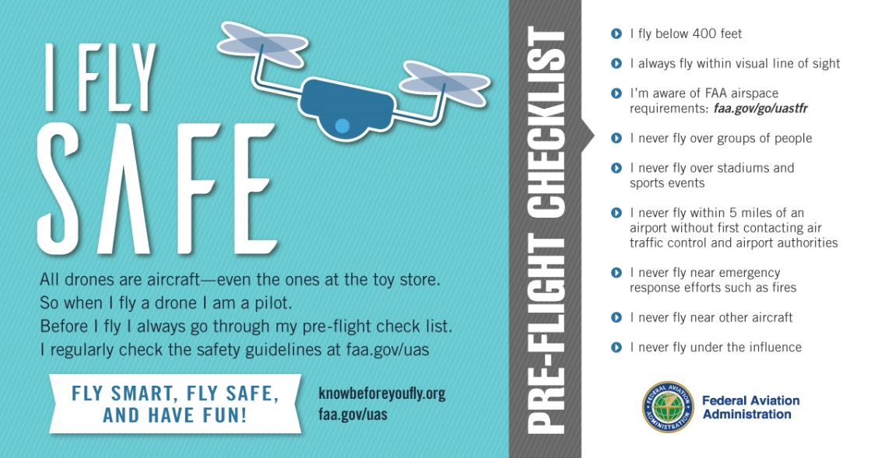
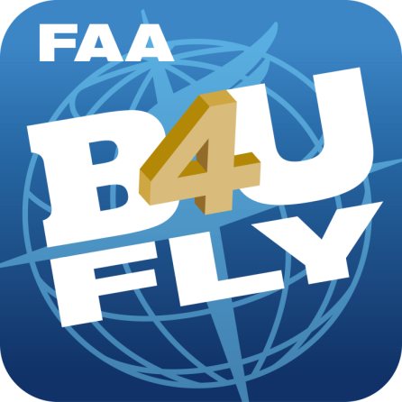
UAS Outreach and Education
Notes:
I Fly Safe Campaign
Educating UAS users about their responsibilities as drone pilots to fly safely
Pre-flight safety checklist provides basic safety rules for flying for fun/recreation
B4UFLY App
Designed to provide model aircraft situational awareness of any restrictions or requirements prior to flight
Launched January 6, 2016 for IOS (available in App Store), and March 14 for Android version (available in Google Play Store)
App Features:
A clear “status” indicator that immediately informs the operator about their current or planned location
Information on the parameters that drive the status indicator
A “Planner Mode” for future flights in different locations
Informative, interactive maps with filtering options
Links to other FAA UAS resources and regulatory information
Know Before You Fly Campaign
Partnership with leading industry groups to inform UAS users about how to fly safely and responsibly
Launched December 2014
Several leading manufacturers include outreach materials in UAS packaging
No Drone Zone Campaign
Reinforces that DC and cities and towns within a 15-mile radius of Reagan National Airport are “No Drone Zone”
Goal to ensure residents and tourists understand that flying UAS for any purpose is against the law in this Flight Restricted Zone
Violators can be fined and face criminal penalties
Includes furnishing materials to federal, state, and local partners in the National Capital Region

Slide 22
Part 107 Inquiries
UAS Help Line: 844-FLY-MY-UAS
UAS Email: UASHelp@faa.gov
Notes:
Suggest that the subject line should be something related to the conference so as to flag it for review

Slide 23
Questions?
www.faa.gov/uas

Slide 24
Backup Slides

Slide 25
Waivable Provisions of Part 107
Operation from a moving vehicle or aircraft (§ 107.25)
Daylight operation (§ 107.29)
Visual line of sight aircraft operation (§ 107.31)
Visual observer (§ 107.33)
Operation of multiple small UAS (§ 107.35)
Yielding the right of way (§ 107.37(a))
Operation over people (§ 107.39)
Operation in certain airspace (§ 107.41)
Operating limitations for small UAS (§ 107.51)
Online portal available at www.faa.gov/uas/request_waiver/

Slide 26
Aeronautical Knowledge Exam Topics
Applicable regulations relating to small unmanned aircraft system rating privileges, limitations, and flight operation
Airspace classification and operating requirements, and flight restrictions affecting small unmanned aircraft operation
Aviation weather sources and effects of weather on small unmanned aircraft performance
Small unmanned aircraft loading and performance
Emergency procedures
Crew resource management
Radio communication procedures
Determining the performance of small unmanned aircraft
Physiological effects of drugs and alcohol
Aeronautical decision-making and judgment
Airport operations
Maintenance and preflight inspection procedures

